Slide 1
PERSON objects in the RIPE Database
Notes:
<number>

Slide 2
The Issue
There are 2+ million referenced PERSON objects, with 8+ million total objects
23% of RIPE Database is personal data
There are also about 104k ROLE objects, some may contain personal data

Slide 3
Justification for storing personal data
T&C define one purpose of Database as facilitating contact for operational issues
Address policies require contact details for resource holders and
some end users of public address space
Address policies acknowledge privacy concerns

Slide 4
Who are these people?
About 1.5m have a single reference from INET(6)NUM objects
these may be tech contacts
or could be customers with assigned address space
Half a million have same name/phone, probably duplicates

Slide 5
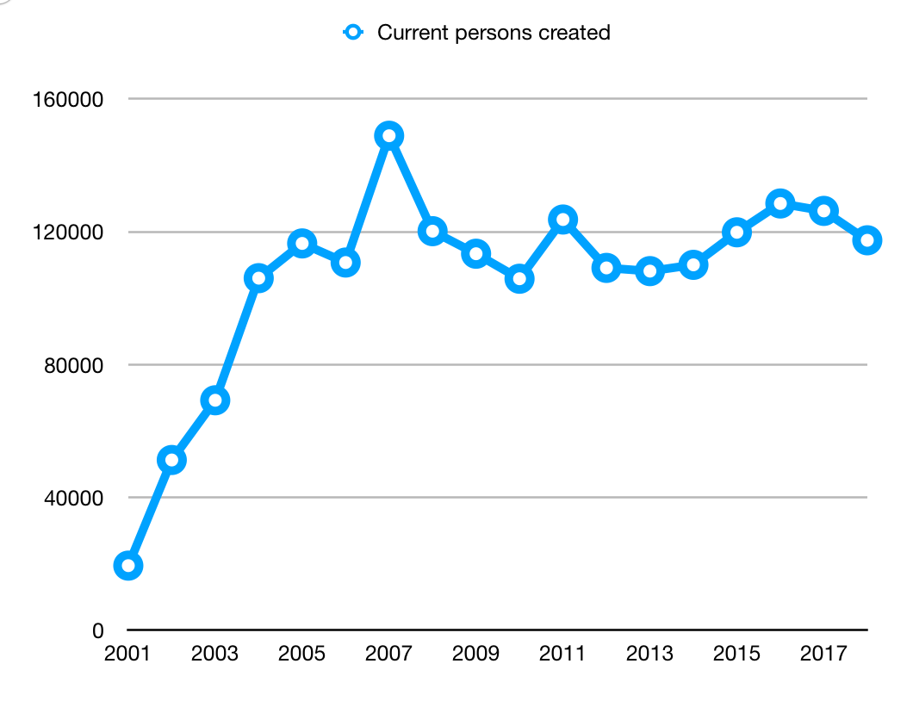
Creation
There has been a steady creation rate for about 15 years

Slide 6
Email addresses
There are about 100k unique email addresses in various notification attributes
These may also be a mix of personal and corporate data

Slide 7
Is there a problem?
From the analysis I’ve done so far it is not possible to identify how much of
this personal data can be justified
Maybe 90% is justified, or perhaps only 20%
With general EU privacy laws and GDPR in particular,
does this give (someone?) a legal problem?
Who is accountable for this personal data being in the database?
If the justification for this data being in the database is questioned,
who will take the responsibility for answering that question?

Slide 8
What is a contact?
Original Database design intended PERSON objects to be mainly referenced
from ROLE objects, all other objects to reference the ROLE objects
This wasn't enforced by the software
Historically most users ignored ROLE objects in favour of PERSON objects
MNTNER objects cannot be created without a PERSON object
No where is it documented that PERSON objects
should contain business data

Slide 9
What is a contact?
"abuse-c" was specifically designed to enforce the use of ROLE objects
ROLE objects no longer need to reference PERSON objects
Why can't most contacts be roles?
Should the software (finally) enforce that?
What information is needed from a contact?
Can we justify storing personal data for a contact
if no personal data is needed?

Slide 10
Distribution
How are these 2m PERSON objects linked to organisations?
No apologies for the dryness of these numbers
They need to be seen as they are quite surprising

Slide 11
Organisations with 100k+ PERSON objects
3 Telekom companies totaling 856k
Top organisation has 613k PERSON objects
5 x what next 2 organisations have
10 x what most other Telekom organisations have
Why?

Slide 12
Organisations with 5k to 50k PERSON objects
After the top 3 there is a drop to around 50k
43 organisations totalling 704k PERSON objects

Slide 13
Who are these organisations?
Summarising the organisations with 5k+:
46 organisations
35 telekom
7 service providers
4 others
Totalling 1.56m PERSON objects
110 organisations between 1k and 5k, totalling 230k PERSON objects
Everyone else totalling 233k PERSON objects

Slide 14
What next?
We still don't know if these people are contacts
We still don't know if these PERSON objects contain
personal or business data
Contact details not changed in 20 years (address, fax-no?)

