Slide 1
AFRINIC RIR Report
RIPE-77, Amsterdam
Alan Barrett, CEO, AFRINIC
19th October 2018

Slide 2
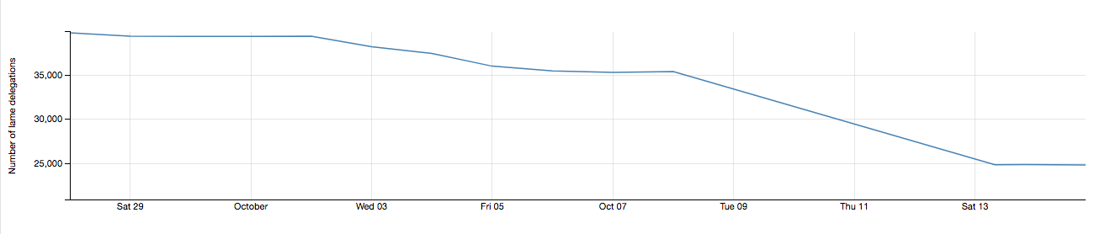
Lame delegations
AFRINIC is implementing the policy Lame Delegations in the AFRINIC reverse DNS.
AFRINIC sends emails to members whose reverse DNS has lame delegations.
AFRINIC deletes non-compliant nameservers from the WHOIS database.
Number of lame delegations
Notes:
Background
The policy ensures that lame delegations appearing in the reverse DNS are acted upon by equipping the WHOIS with automatic checks, notifications to admin-c, tech-c and zone-c contacts of domain objects and removal of lame delegations after 30 days.
The graph shows a decrease in the number of lame delegations over the past month from 40,000 that were originally detected upon implementation of the policy.
Actual number shows 25,000.

Slide 3
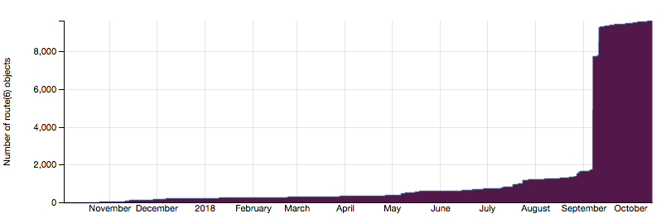
Adoption of the AFRINIC IRR
Effective September, the RIPE NCC IRR no longer supports the creation of route(6) and aut-num objects that refer to out-of-region resources
AFRINIC has removed the need for the ASN holder to authorise any route or route6 objects in the AFRINIC IRR.
Number of route+route6 objects in AFRINIC IRR
Notes:
Out-of region resources refer to Resources that were not delegated to the RIPE NCC by IANA.
It is now easier to create route and route (6) objects in the AFRINIC IRR since AFRINIC has removed the need for the ASN holder to authorise any route or route 6 object in the AFRINIC IRR
The graph shows a sharp increase in AFRINIC IRR Adoption in September – October when RIPE NCC announced changes in its IRR. Number of route objetcs created shows 10,000. 37% membership of AFRINIC membership are using the IRR at October 2018.

Slide 4
IPv6 Policies
No. | Policy | Brief | Status
1 | IPv6 Policy and References Update | Removes/corrects several inconsistencies in current IPv6 policy text and improves on the definition for “utilization” | Ratified, Implementation imminent
2 | IPv6 PI Update | Updates the relevant text in the CPM to accommodate the possibility to obtain IPv6 PI space even if the requesting party has no IPv4 PI space. | Ratified, Implementation imminent
3 | IPv6 Initial Allocation Update | Ensures policy text is aligned with a wider set of possible IPv6 deployment cases and facilitates easier justification of subsequent allocations. | Ratified, Implementation imminent

Slide 5
Policies under discussion
No. | Policy | Brief | Status
1 | AFRINIC PDP-bis | Proposes changes to the current PDP | Under discussion
2 | Internet Number Resources’ Review | Allows AFRINIC to conduct routine (or whistle-blower triggered) resource audits on members. | Under discussion
3 | IPv4 Soft Landing bis | A complete replacement of the current Soft Landing policy (CPM 5.4) | Under discussion
4 | Abuse Contact Policy Update | Aims to solve the problem of contact information that is inaccurate for reporting abuse incidents from concerned IP address blocks | Under discussion
5 | Clarification on IPv6 Sub-Assignments | Introduces a concept to further re-assign (or sub-assign) IPv6 PA assignments from an IPv6 block downstream. | Under discussion
Notes:
AFRINIC PDP-bis:
Proposes changes to the current PDP, with clearer mechanisms for appeals and disputes, introduction of distinct phases in the policy proposal life cycle and more transparency around consensus-gauging.
Internet Number Resources’ Review:
Allows AFRINIC to conduct routine (or whistle-blower triggered) resource audits on members and provides for revocation of resources (and closure of members) that fail such audits (reviews).
IPv4 Soft Landing bis:
Complete replacement of the current Soft Landing policy (CPM 5.4)
New maximum allocation sizes (/18 for phase 1 of exhaustion, /22 for phase 2 of exhaustion). Phase 2 starts when remaining free pool hits /11. Sets a 2-year wait period for subsequent allocation if a member has already been allocated maximum space in either phase.
Reserves a /12 to ‘facilitate IPv6 deployment’.
Abuse Contact Policy Update:
Aims to solve the problem of contact information that is inaccurate for reporting abuse incidents from concerned IP address blocks .
Clarification on IPv6 Sub-Assignments:
Introduces a concept to further re-assign (or sub-assign) IPv6 PA assignments from an IPv6 block downstream.

Slide 6
afrinic
afrinic
afrinic
afrinic
afrinic
afrinic
twitter.com/
flickr.com/
facebook.com/
linkedin.com/company/
youtube.com/
www.
media
.net
Thank you.

