Slide 1
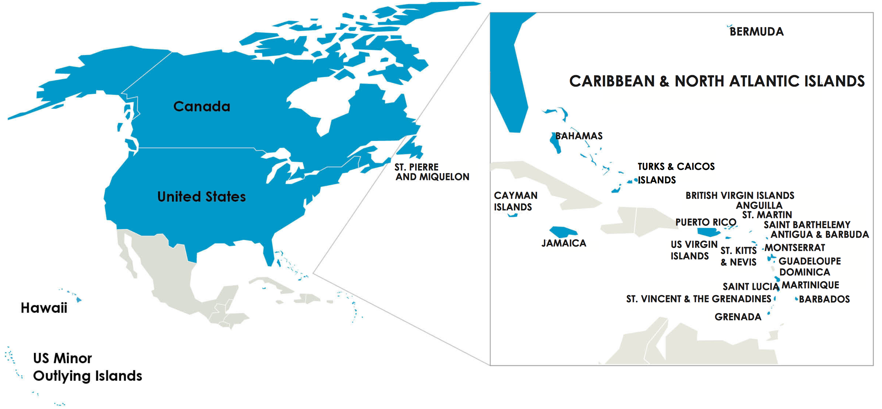
Update
ARIN Serves:
The United States
Canada
More than 25 Caribbean and North Atlantic economies
Served Organizations: 38,000+
16,000+ Legacy resource holders 5,851 Member Organizations.

Slide 2
the latest
Website redesign underway, to be deployed early 2019.
Continued user testing and community feedback collection
Robust community engagement and responsiveness
Nine community consultations
ARIN Bits (our quarterly e-news update)
2018 Consultations
Internet Routing Registry (IRR) Roadmap
ASO Future Structure Consultation
Securing Whois Queries
ARIN Board Expansion
Fee Schedule Changes
Open Suggestions
Mailing List Attachments
Orphaned Point of Contact and Organization Records
Specified Transfer Listing Service Changes

Slide 3
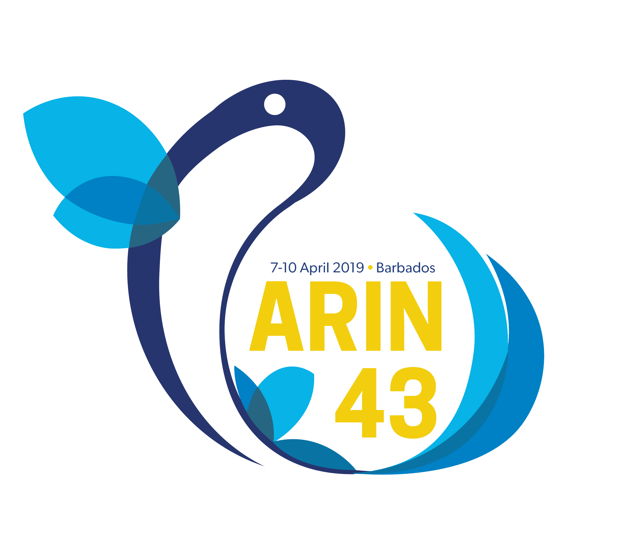
Community Outreach
ARIN on the Road/ARIN in the Caribbean
Outreach and training for government & law enforcement
Major focus on Caribbean Internet development, outreach and facilitating participation with ARIN across a range of areas
User-focused blog and video content directly from Registration Services staff in response to community feedback
Notes:
Notes:
ARIN Customer Lunches:
This lunch is tailored for ARIN customer organizations that may not have much visibility into the inner workings of ARIN. During lunch, ARIN staff will present an overview of current ARIN activities and services. Come hear about obtaining IPv6 addresses, the transfer market, ARIN directory services, the policy development process, providing feedback to ARIN and more.
ARIN Bits: Latest version went out on 9/18

