Slide 1
MANRS for IXPs
Why we did it?
What did we do?
__________________________________________________________
Andy Davidson <andy@asteroidhq.com> RIPE77, Amsterdam
17th October 2018

Slide 2
MANRS?
Demonstrate commitment to a collective culture of responsibility
For internet resilience
For security of the routing system
Apply minimum level of best practice at inter-domain border
Filter incorrect routing information
Filter traffic with spoofed IP address sources
Encourage co-ordination and collaboration between operators
Expressed in a number of Actions. Initiated and co-ordinated by ISOC.

Slide 3
MANRS for IXPs?
MANRS actions apply to dirty layer three networks not pure, clean, honest IXP Ethernet domains
We can (continue to) get away with doing no work at all

Slide 4
MANRS for IXPs?
MANRS actions apply to dirty layer three networks not pure, clean, honest IXP Ethernet domains
We can (continue to) get away with doing no work at all
…actually if this was ever true, it is certainly no longer true

Slide 5
MANRS for IXPs!
IXPs are important partners
Focal point for collaboration
Co-ordination of regional internet development and education
Route-Servers are popular and must be secured
Layer 2 hygiene is still important

Slide 6
MANRS Actions
Prevent propagation of internet routing information (M)
Promote MANRS to the IXP membership (M)
Protect the peering platform
Facilitate operational communication between operators
Provide monitoring and debugging tools to members

Slide 7
MANRS actions
Prevent propagation of internet routing information (M)
Same burden on IXP operator as on layer 3 carrier
No customer BGP relationship should be unfiltered
Networks outsource peering hygeine to route-server

Slide 8
MANRS IXP Adoption
24 IXPs
https://www.manrs.org/ixps/ixp-participants/
Could you be next?

Slide 9
Why we adopted MANRS?
Be good internet citizens
Reduce likelihood of emergency support incident
Increased confidence in automation
Barrier was extremely low, most work had been done

Slide 10
How Asteroid adopted good MANRS
Build script will not include a peer on route-server unless
Route-server flag in database is set to true (customer controlled)
as_macro is defined in asteroid database for customer
as_macro expands in RIR IRRDBs to a prefix list of at least one prefix
Prefixes MUST be defined for a BGP session to be built

Slide 11
Protect the peering platform
Common Sense policy, enforced with port template
Identical port configuration handled by port rollout script
Filtering link layer protocols (e.g. LLDP, BPDUs, etc.)
MAC Port-Security
Scripts on collector to identify prohibited traffic
Unannounced, public Peering LAN IPv4/6 addresses

Slide 12
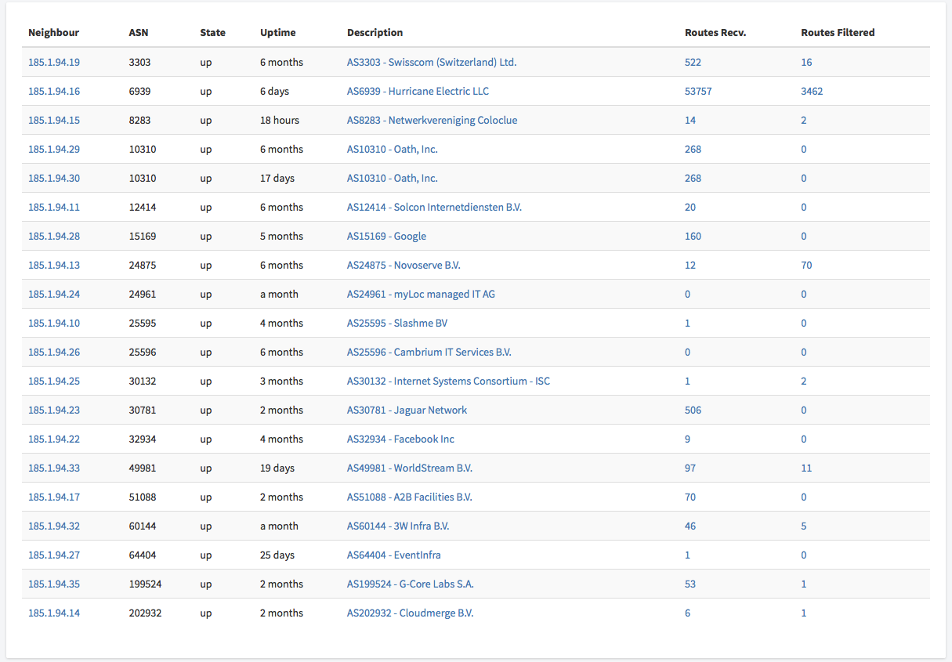
Provide a looking glass
Alice, from our friends at ECIX

Slide 13
MANRS compatible with Asteroid values
Lightweight and efficient approach
Simple to automate, easy to use
Low cost
Origin in trustworthy, collaborative co-operation

Slide 14
Embedded into our product
White Label IXP-in-a-box platform
Public Exchange Points
Amsterdam, Netherlands
Mombasa, Kenya

